Slide 1

Forecasting Internet Traffic Prediction
Mentor - Parth Sagar
31/03/2022
Team no 6
Chaitali Shirke
Ashwini Shivdas
Arundhati Ghanade
Roshani TV
Shanaz Hossain dewan
Krushna Naphade
Akash Yallatti

Slide 2
BUSINESS OBJECTIVE
In this project we will forecast the Internet traffic using time-series models as ARIMA and Holt-Winters. This project involves comparing the performance of the time-series prediction models designed different approaches.

Slide 3
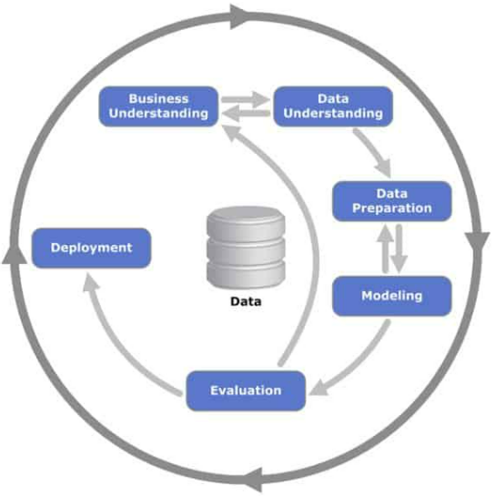
Project Architecture / Project Flow

Slide 4
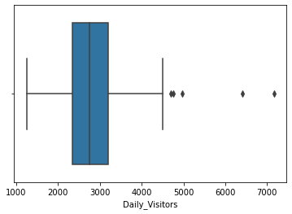
EXPLORATORY DATA ANALYSIS
Insights of the dataset:
173 rows & 2 columns
No Null values and duplicate values observed
No outliers detected
Data doesn’t look normal

Slide 5
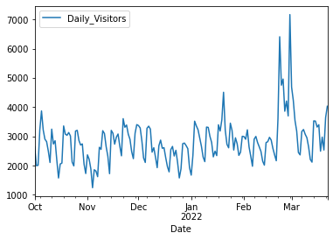
Data understanding
Date wise plot for daily visitors
End of February 2022 and start of March 2022 there is sudden increase in daily visitors.

Slide 6
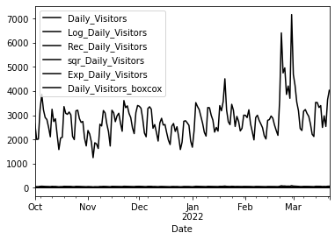
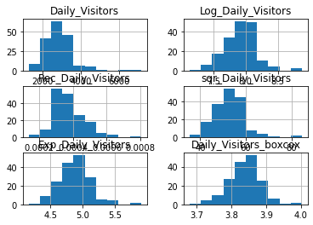
Transforming to Normal Distribution
Transforming techniques used:
logarithmic transformation
Reciprocal transformation
Square-root transformation
Exponential transformation
Box – cox transformation
transformations data is
Not normal so we moved ahead
Without transformation

Slide 7
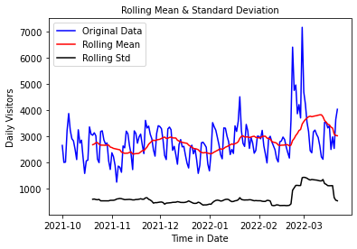
Stationarity Check
Test stationary using Augmented Dickey Fuller’s Test.
The Visitors mean and the variation in standard deviation (black line) clearly vary with time. This shows that the series has a trend. So, it is not a stationary. Also, the Test Statistic is greater than the critical values with 90%, 95% and 99% confidence levels. Hence, no evidence to accept the null hypothesis. Therefore the series is nonstationary
Test Statistic -2.358587
p-value 0.153768
#Lags Used 14.000000
Number of Observations Used 158.000000
Critical Value (1%) -3.472431
Critical Value (5%) -2.880013
Critical Value (10%) -2.576619
dtype: float64
Failed to accept null hypothesis. Data is non-stationary

Slide 8
Transforming the dataset to stationary
The most common techniques used to estimate or model trend and then remove it from the time series are:
Aggregation – taking average for a time period like monthly/weekly average
Smoothing – taking rolling averages
Polynomial Fitting – fit a regression model
We have used smoothing method here. Smoothing refers to taking rolling estimates, i.e. considering the past few instances.
Two ways of smoothing used here are: 1. Moving Average 2. Eliminating trend & seasonality
Eliminating trend & seasonality further contains two methods: Differencing & Decomposing.
We will use other smoothing techniques like Single Exponential smoothing, Double exponential smoothing using Holt-winter Function.
Lets see how different techniques gives required results:

Slide 9
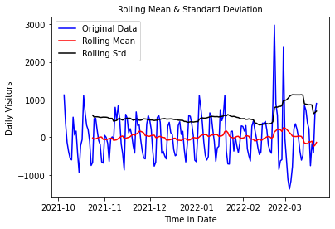
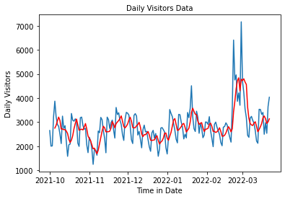
1. Moving Average
In this technique, we take average of ‘k’ consecutive values depending on the frequency of time series. Here, we will take the average over the past 5 Months.
The rolling mean values appear to be highly varying. The Test Statistic is smaller than the 10% 5%, and 1% of critical values. So, we can say with 99% confidence level that the dataset is a non stationary series.
Test Statistic -2.358587
p-value 0.153768
#Lags Used 14.000000
Number of Observations Used 158.000000
Critical Value (1%) -3.472431
Critical Value (5%) -2.880013
Critical Value (10%) -2.576619
dtype: float64
Failed to accept null hypothesis. Data is non-stationary

Slide 10
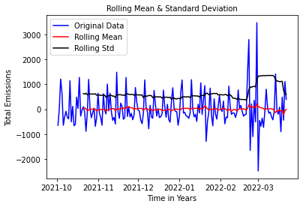
2. Eliminating Trend & seasonality : Differencing
Differencing : One of the most common methods of dealing with both trend and seasonality is differencing. In this technique, we take the difference of the observation at a particular instant with that at the previous instant. the dataset is a non stationary series.
1. First order difference:
Test Statistic -2.358587
p-value 0.153768
#Lags Used 14.000000
Number of Observations Used 158.000000
Critical Value (1%) -3.472431
Critical Value (5%) -2.880013
Critical Value (10%) -2.576619
dtype: float64
Failed to accept null hypothesis. Data is non-stationary
The first difference improves the stationarity of the series. Let us use also the seasonal difference to remove the seasonality of the data and see how that impacts stationarity of the data.

Slide 11
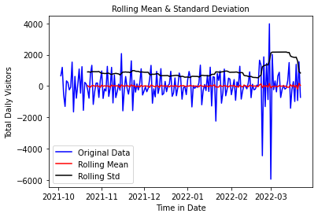
2. Seasonal first order difference:
Now, if we look the Test Statistic and the p-value, taking the seasonal first order difference has made our the time series dataset stationary. We are considering this seasonal first difference for further analysis because it looks more stationary
Test Statistic -6.432838e+00
p-value 1.680769e-08
#Lags Used 1.300000e+01
Number of Observations Used 1.570000e+02
Critical Value (1%) -3.472703e+00
Critical Value (5%) -2.880132e+00
Critical Value (10%) -2.576683e+00
dtype: float64
Failed to reject null hypothesis. Data is stationary

Slide 12
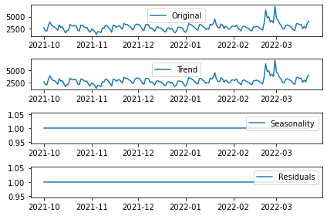
3. Eliminating Trend & seasonality : Decomposing
In this approach, both trend and seasonality are modeled separately and the remaining part of the series is returned.
Here we can see that the trend, seasonality are separated out from data and we can model the trend. Let's check stationarity of trend:

Slide 13
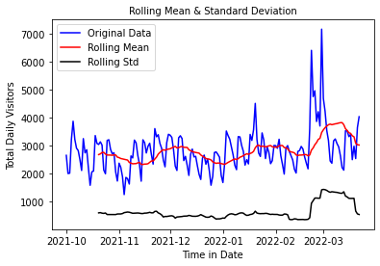
Data remains Non-stationary
Data remains Non-stationary
Test Statistic -2.358587
p-value 0.153768
#Lags Used 14.000000
Number of Observations Used 158.000000
Critical Value (1%) -3.472431 Critical Value (5%) -2.880013 Critical Value (10%) -2.576619 dtype: float64
Failed to accept null hypothesis. Data is non-stationary

Slide 14
MODEL BUILDING

Slide 15
Model Building
Model building done both on Stationary and non-stationary data set
Models used:
ARIMA(Auto Regressive Integrated Moving Average)
AR(Auto Regressive)
MA(Moving Average)
Auto ARIMA
Simple Exponential smoothing
Double Exponential smoothing or Holt’s method
Triple Exponential smoothing or Holt’s –Winter method
Last Sample Technique Method (LSTM) using RNN

Slide 16
Model Building on Stationary data
Now building model on stationary after transforming the original data to stationary data.

Slide 17
Plot the ACF and PACF charts
Autocorrelation Function (ACF): It is a measure of the correlation between the time series with a lagged version of itself.
Partial Autocorrelation Function (PACF): This measures the correlation between the time series with a lagged version of itself but after eliminating the variations already explained by the intervening comparisons.
In the next step we will be determining the tuning parameters (p and q) of the model by looking at the autocorrelation and partial autocorrelation plots. The plot below provides a brief guide on how to read the autocorrelation and partial autocorrelation graphs in order to select the parameters.

Slide 18
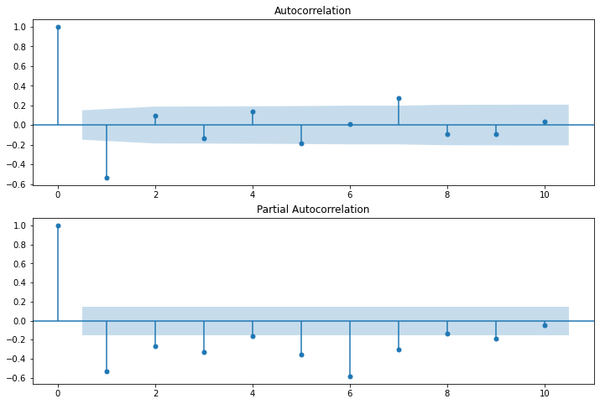
p – The lag value where the PACF chart crosses the upper confidence interval for the first time. If you notice closely, in this case p=2.
q – The lag value where the ACF chart crosses the upper confidence interval for the first time. If you notice closely, in this case q=2.

Slide 19
DATA PARTITIONING
Using Seasonal first order difference for building model for stationary data because it shows more stationarity.
Training Data = Fit the model only to training period
Validating Data = Assess the model performance on validation
Deploy model by training on whole dataset
No random partition That’s because the order sequence of the time series should be intact in order to use it for forecasting.

Slide 20
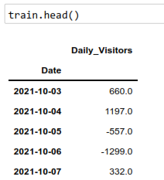
Hyper-parameter Tuning using Grid Search
Done Grid search for hyper-parameters to find out optimal order or (p, d ,q) for ARIMA model.
Best oder found is (0,1,2) with least RMSE.

Slide 21
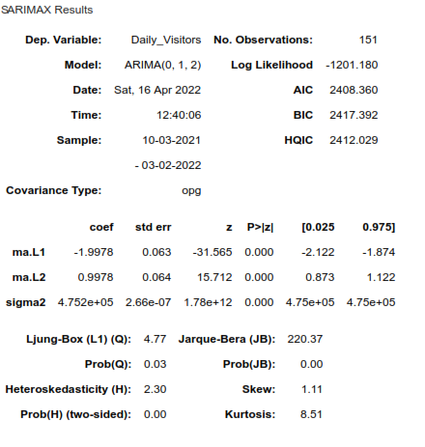
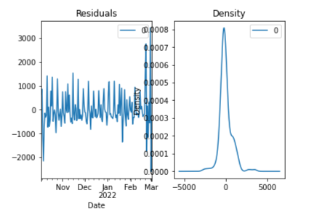
1. Model on Stationary Data
1. Auto Regressive Integrated Moving Average (ARIMA)

Slide 22
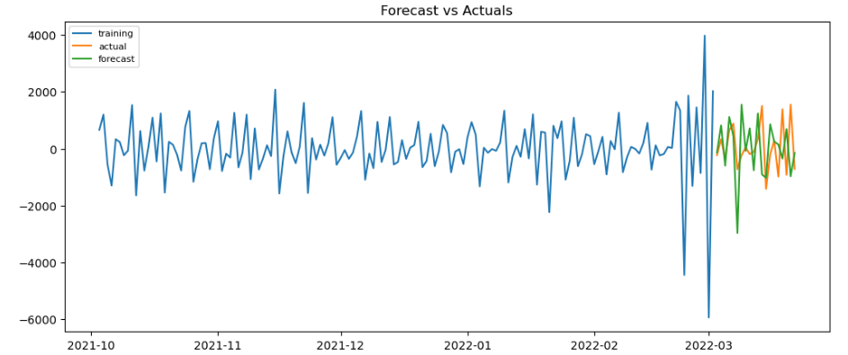


Slide 23
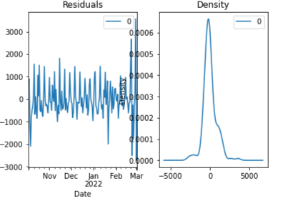
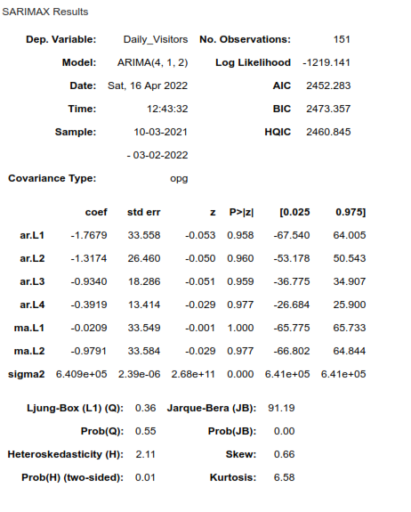
Moving Average (MA) Model

Slide 24
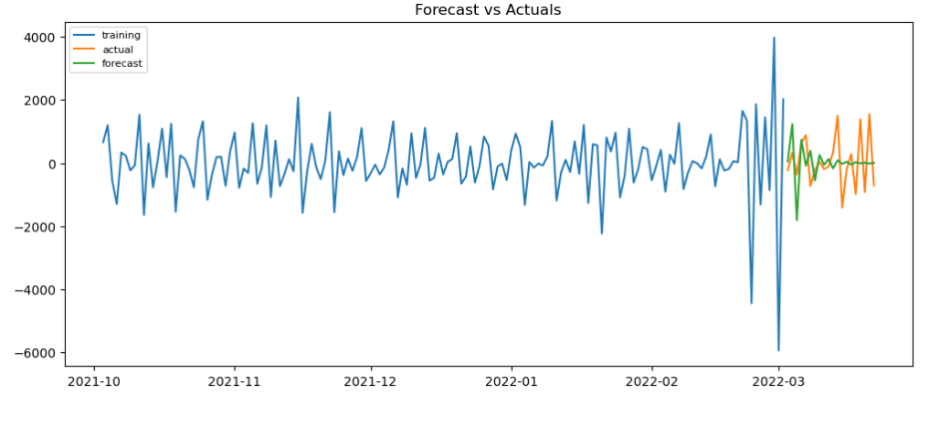


Slide 25
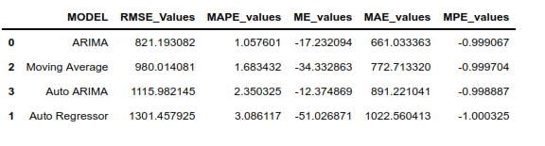
Comparing models build on stationary data
ARIMA gave least RMSE

Slide 26
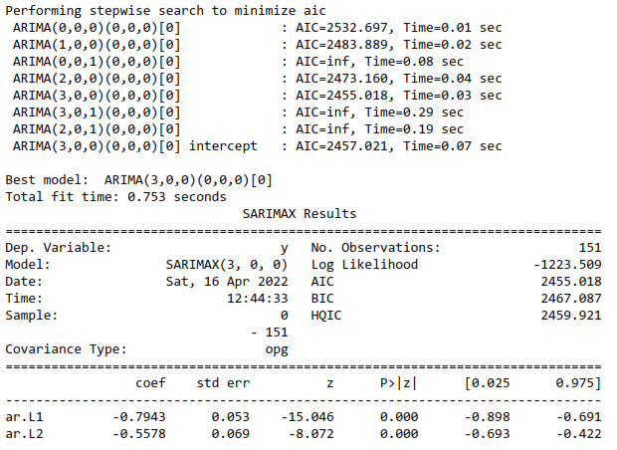
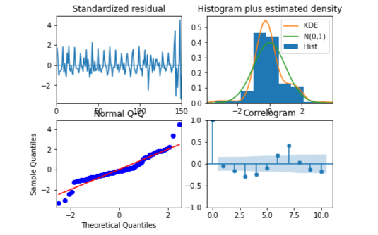
Auto ARIMA Model

